Slide 1

Wheat Price Prediction in India
A Machine Learning Project by Shailesh Gaddam

Slide 2
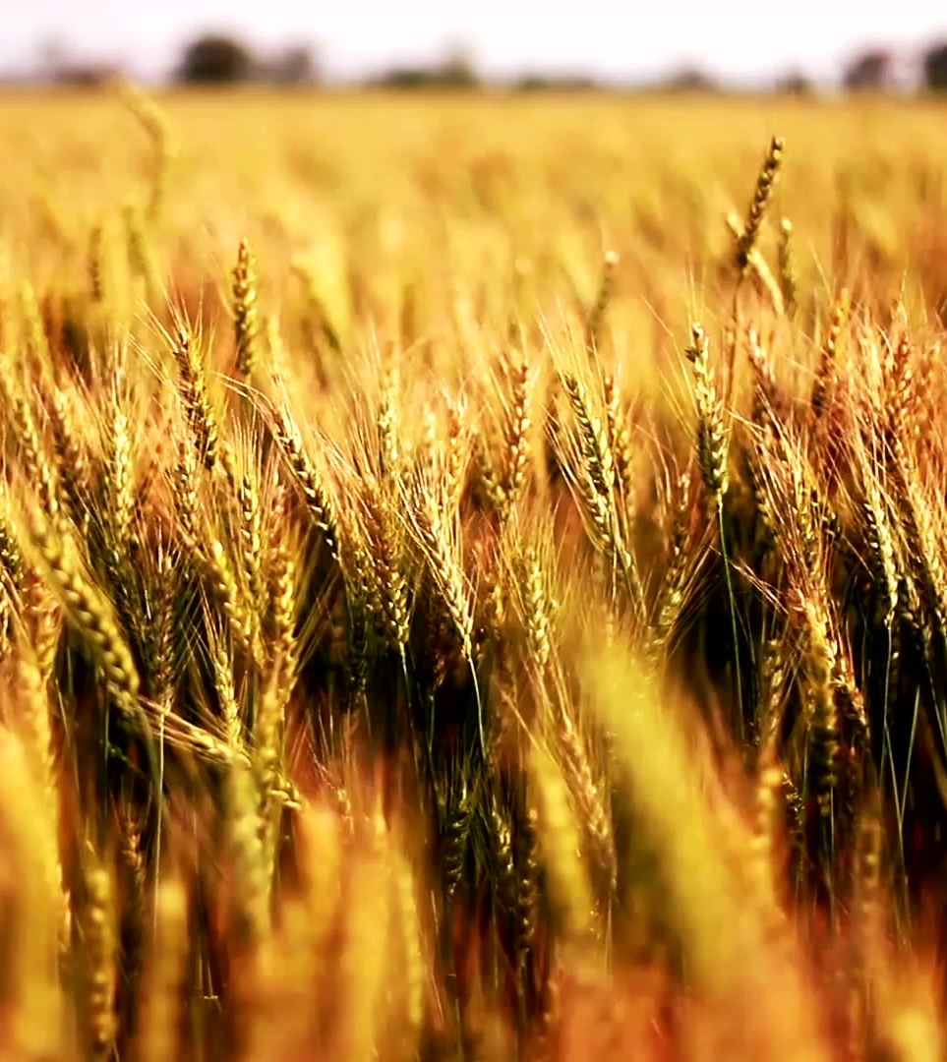
Introduction :
Wheat plays a crucial role in India's agriculture. This project focuses on predicting wheat prices using machine learning techniques across different states, districts, markets, and varieties of wheat.

Slide 3

Objective :
The primary objective is to develop a machine learning model that accurately predicts wheat prices, considering various factors such as geographical location (states and districts), market conditions, and the type of wheat variety.

Slide 4
Project Workflow :
Deployment
6
Model Evaluation
5
Model Building
4
Data Cleaning
3
EDA
2
Data Collection
1

Slide 5

Data Collection :
To build an effective model, diverse datasets will be collected, including historical wheat prices, weather patterns, agricultural practices, and market trends. This comprehensive data will be used to train and validate the machine learning algorithm.
Data Collected from : Dataset Link

Slide 6
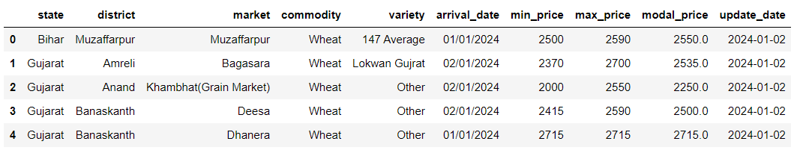
This is how Dataset Looks like:

Slide 7
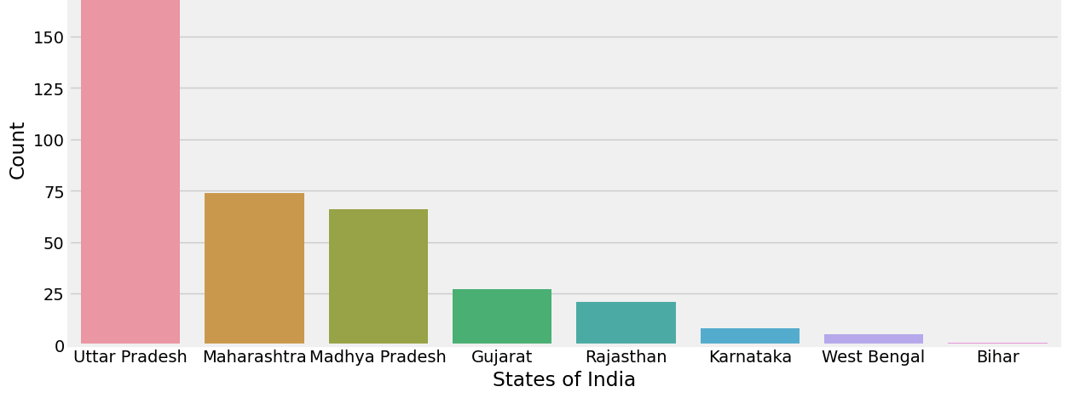
EDA : Wheat Market Analysis based on states

Slide 8
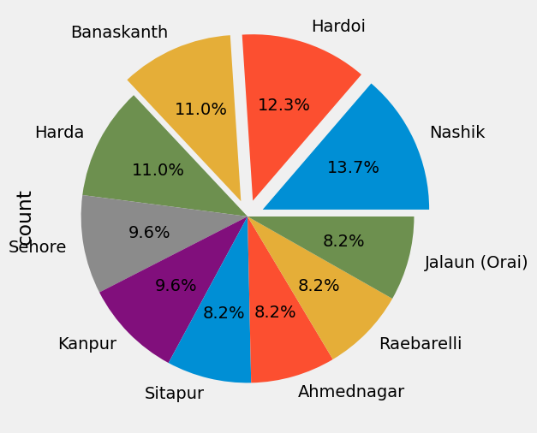
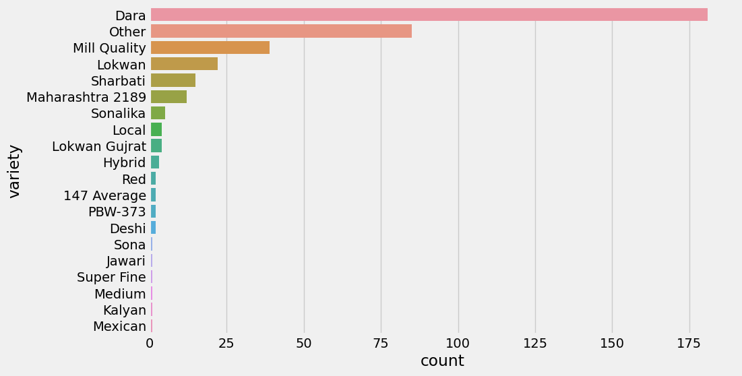
Market and Variety Trends:

Slide 9
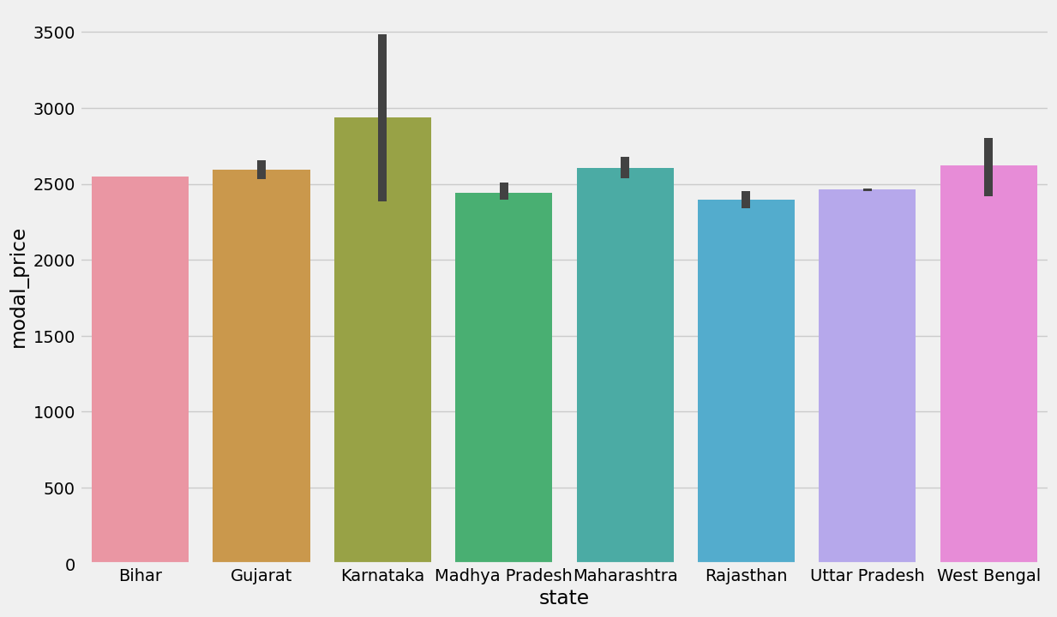
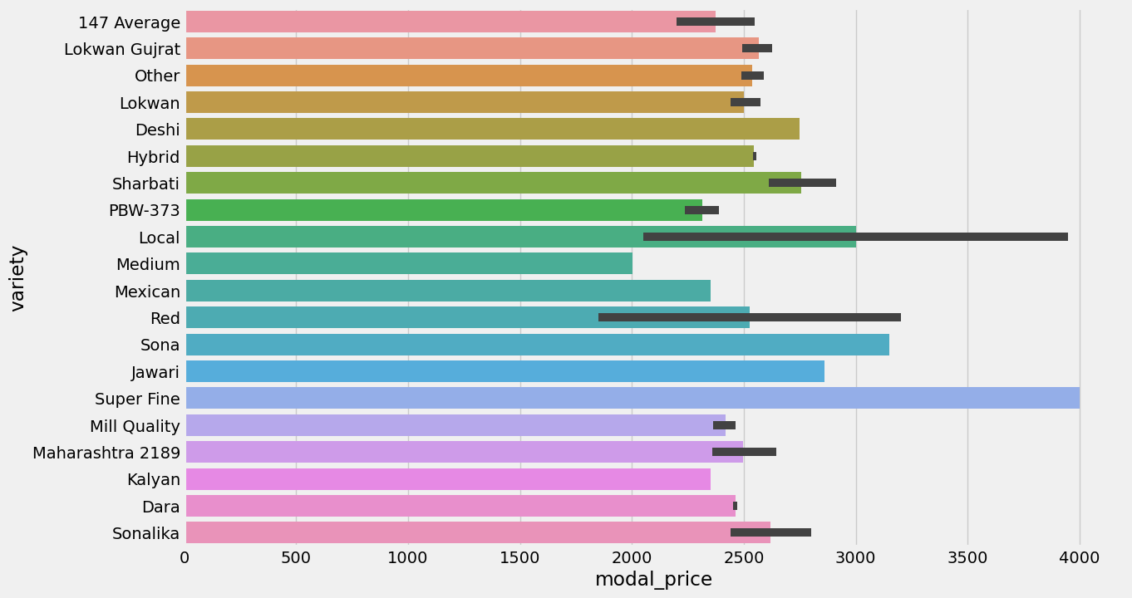
Wheat Varieties Prices :

Slide 10

Data Cleaning
Convert Categorical Features into Numerical Features
Handing Missing Values
Transforming Data using Scaling Method
Removing Unnecessary Column

Slide 11
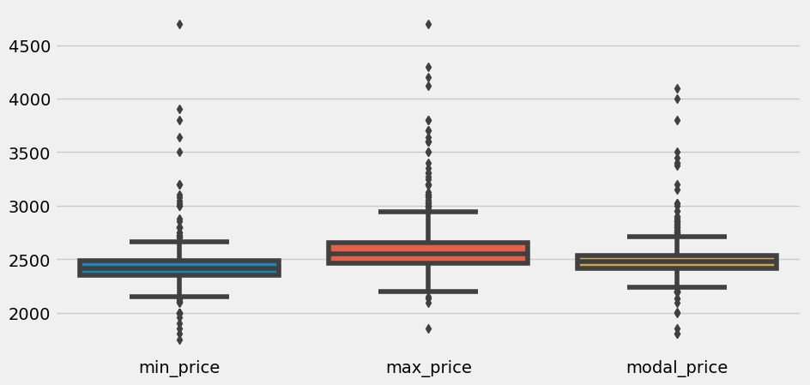
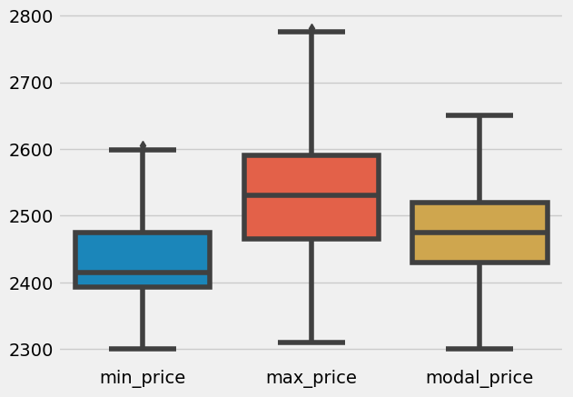
After handling outliers
Before handling outliers
From the above diagram we can see that we have many outliers in our data before handling the outliers in feature engineering part.
From the above diagram we can see that we have removed outliers

Slide 12
Model Building and Evaluation
Considered Models: Linear Regression, Decision Trees, Random Forest
Criteria for Selection: Accuracy, Complexity, Scalability, Robustness
Selected Model: Random Forest

Slide 13




Deployment

Slide 14
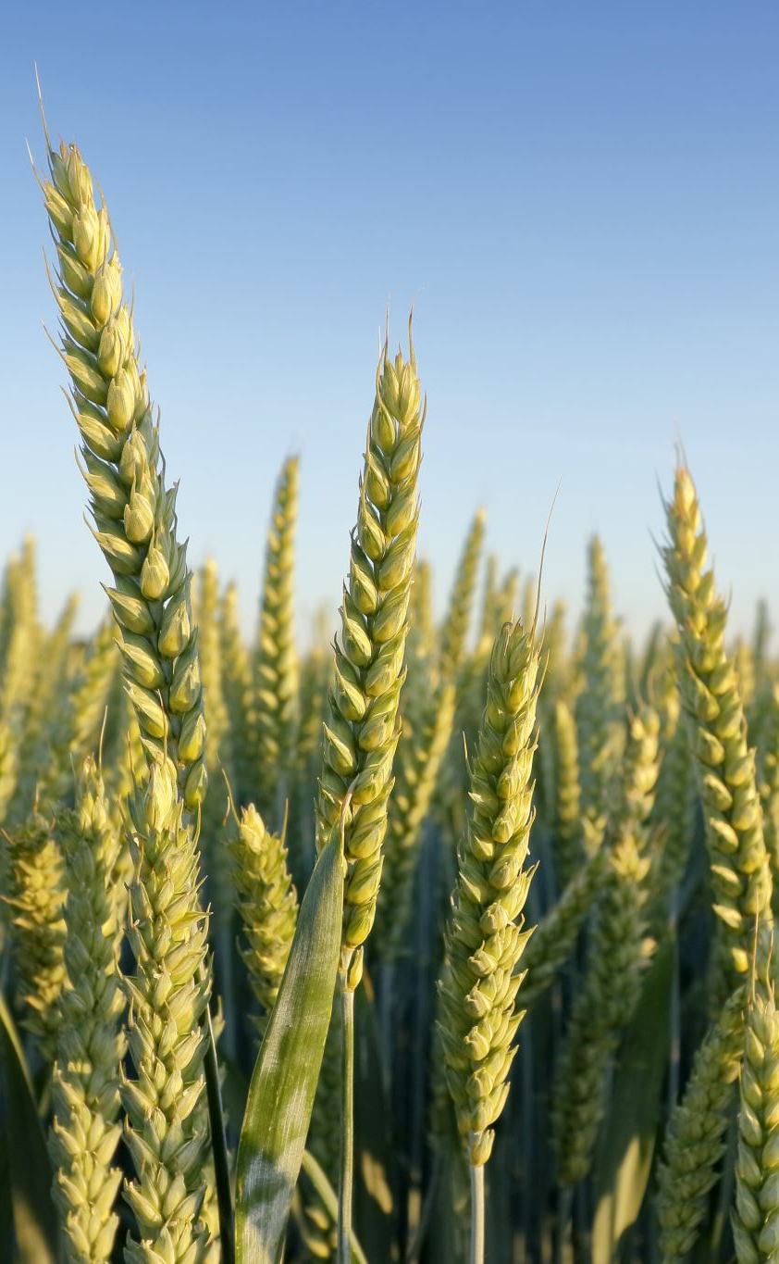
Conclusion
Karnataka have the highest price of wheat crop
Super Fine quality is the most expensive variety crop type
Dara Varity of wheat is the most selling
Uttar Pradesh , Maharashtra and Madhya Pradesh have the highest frequency of the distribution
We have successfully developed a machine learning model capable of predicting wheat prices with good accuracy.

Slide 15
Future Work :
Additional Data Sources: Integration of additional data sources such as crop yield data, and geopolitical factors to enrich the predictive model and enhance its robustness.
Enhancement of Model Interpretability: Implementation of techniques to enhance model interpretability, such as feature importance analysis and model visualization, to provide deeper insights into the factors influencing wheat price fluctuations.
Refinement of Model: Continual refinement of the Random Forest model through hyperparameter tuning and feature engineering to improve predictive performance.
Deployment of Predictive Tools: Improve the user-friendly predictive tools or applications that provide real-time or near-real-time wheat price predictions, catering to the needs of farmers, traders, and policymakers.

Slide 16

Thank you!

